Slide 1
SC4 Results
GM
SOL
TA1
TA2

Slide 2
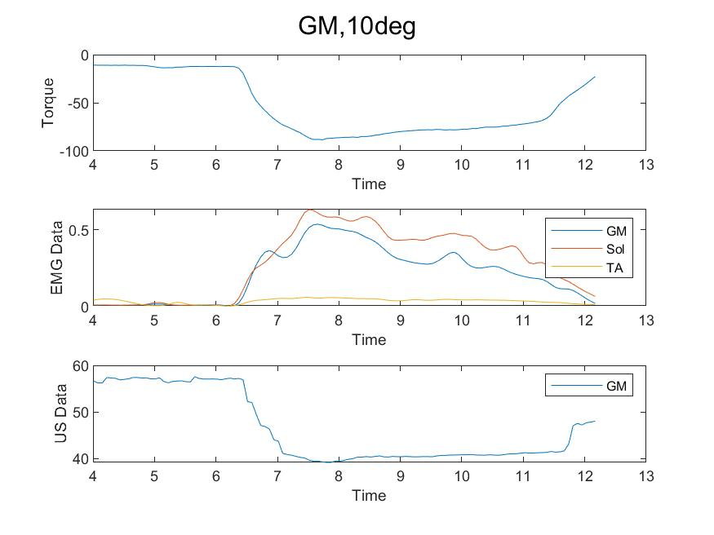
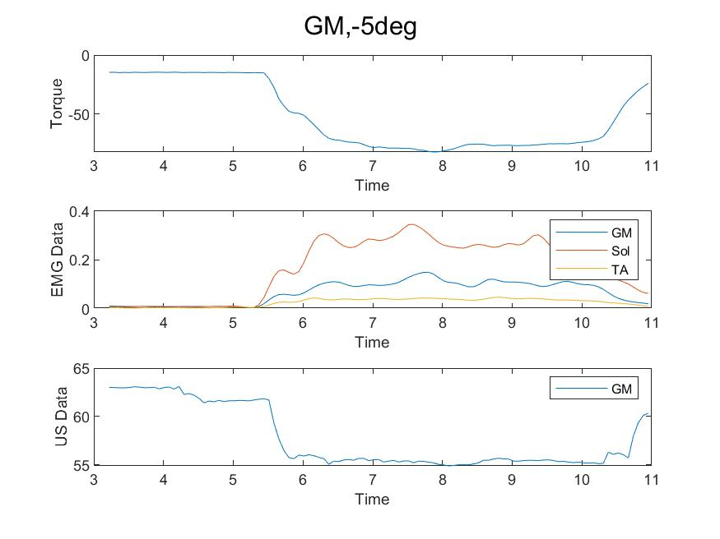
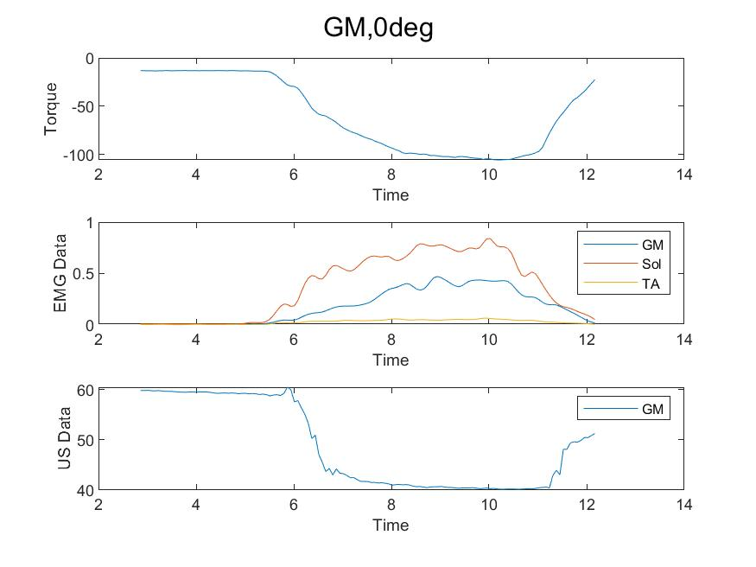
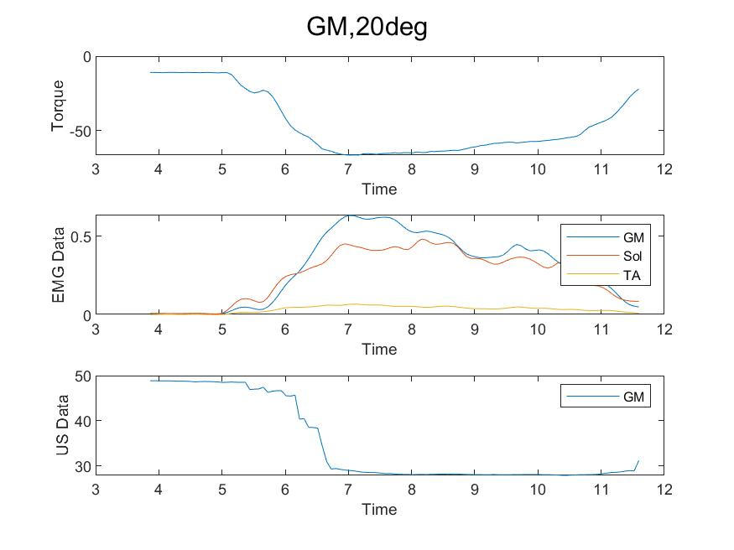
GM: Pre-processing
Comments: Looks OK to me

Slide 3
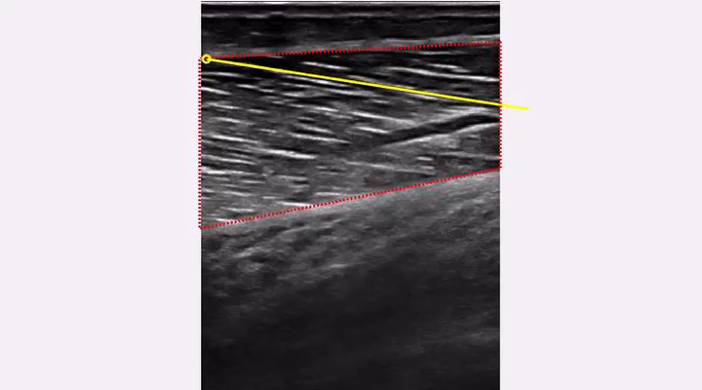
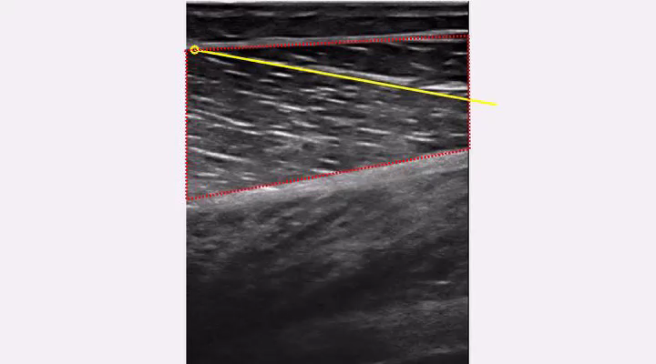
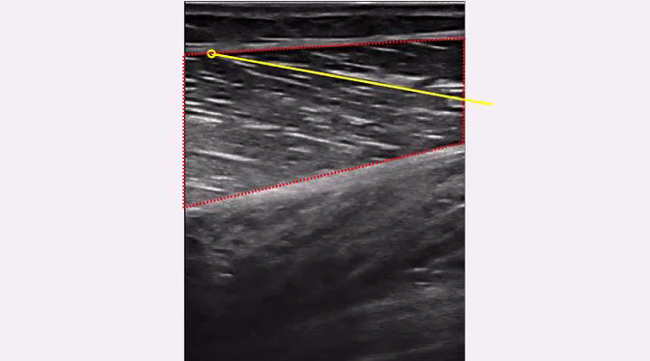
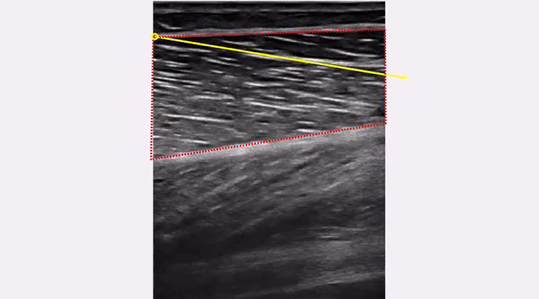
GM: Pre-processing, US Tracking
Comments:
0 degrees
10 degrees
20 degrees
-5 degrees

Slide 4
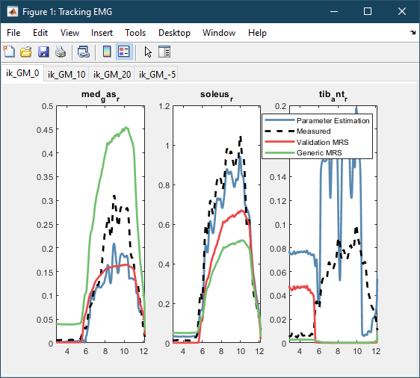
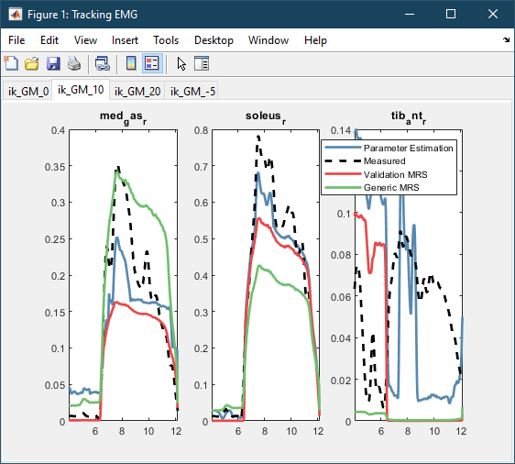
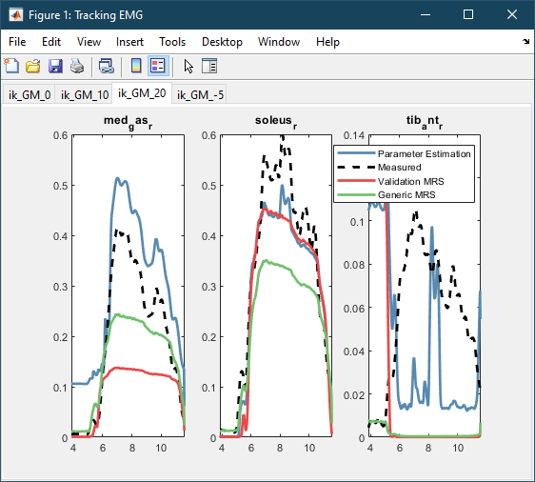
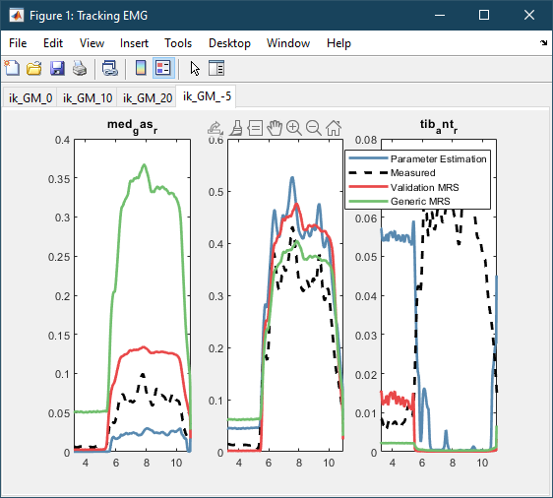
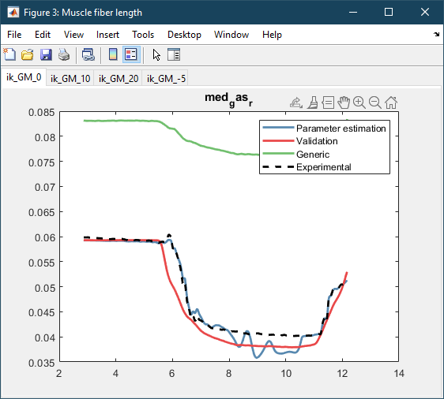
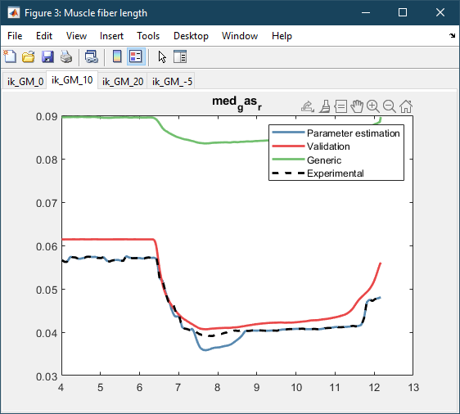
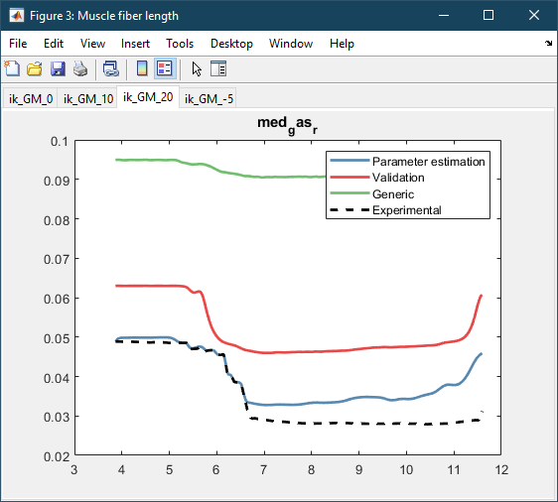
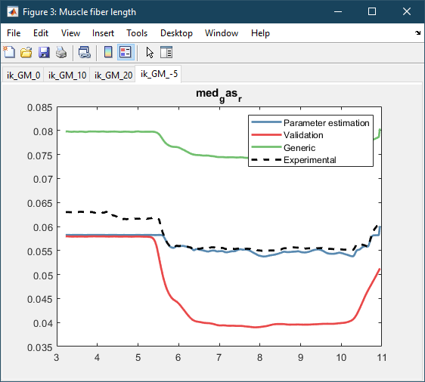
GM: Results
Weights:
wEMG = 0.001 wlM = 1 EMGbounds = [-0.1 0.1] BoundsScaleEMG = [0.2 1.5]
Comments:

Slide 5
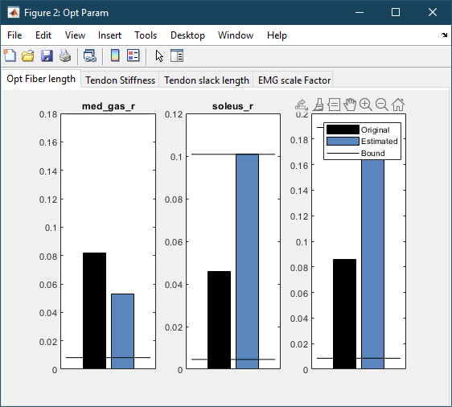
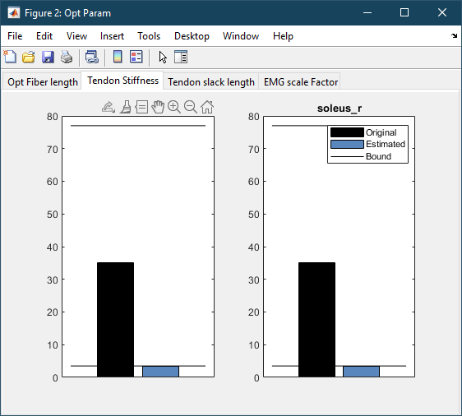
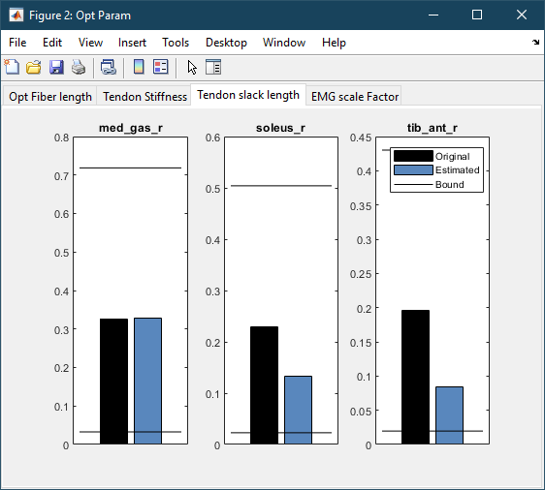
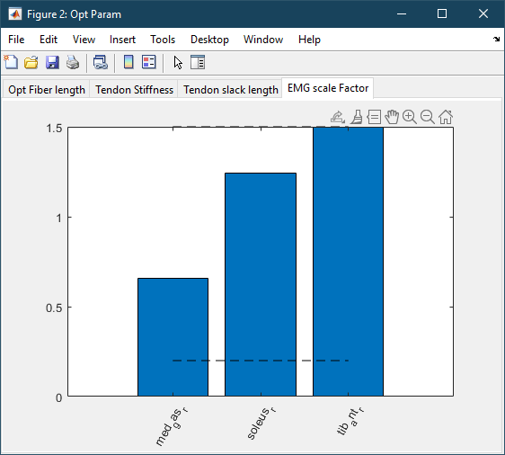
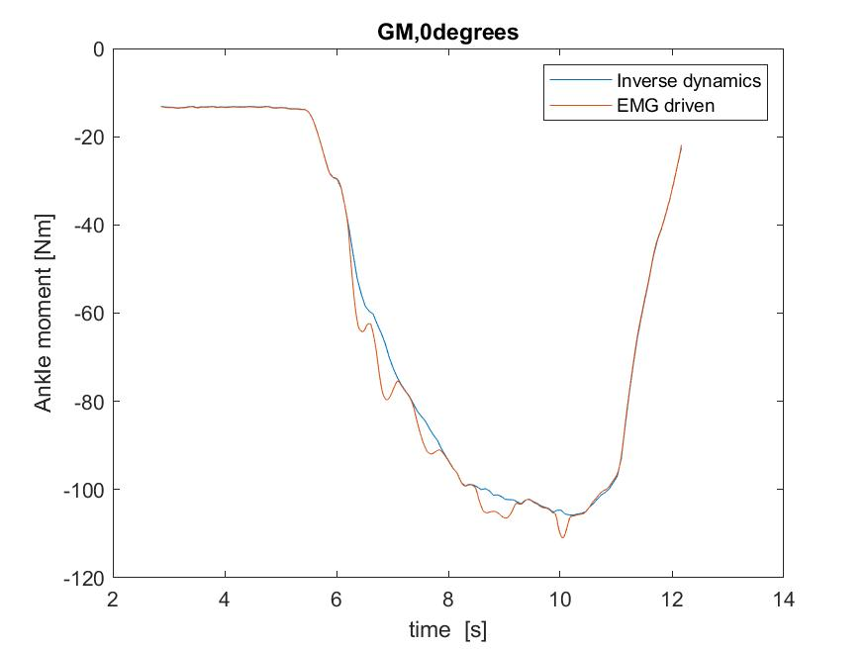
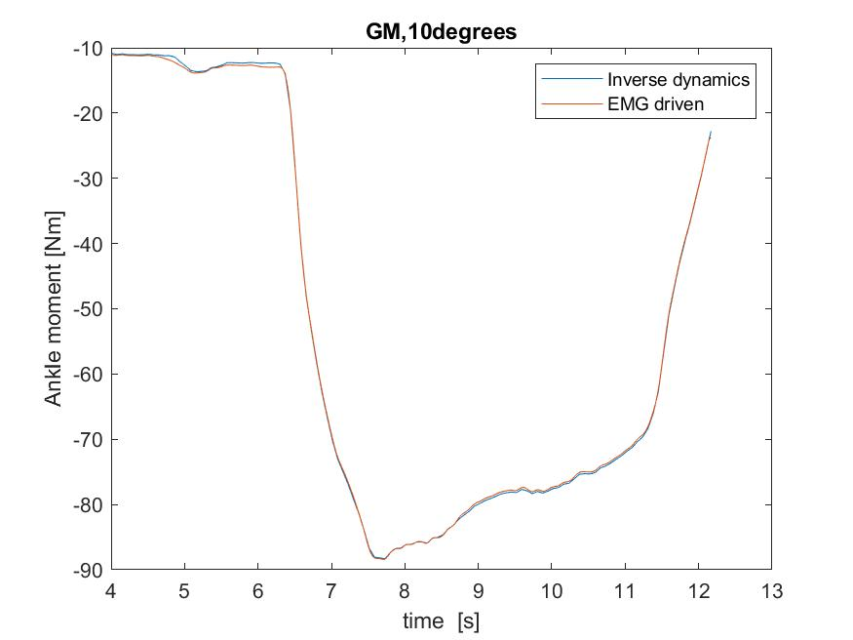
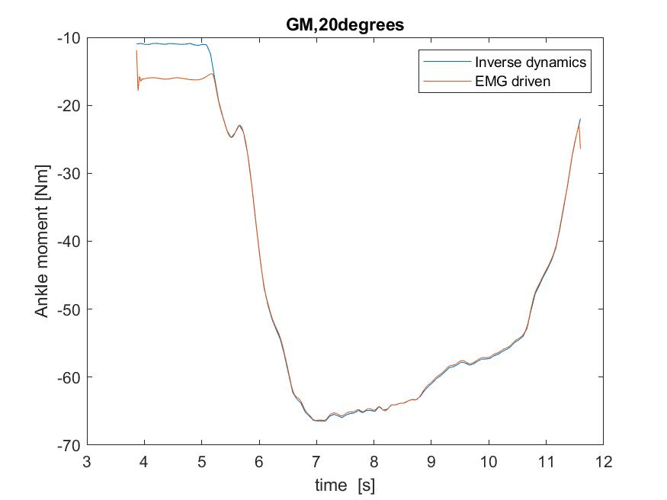
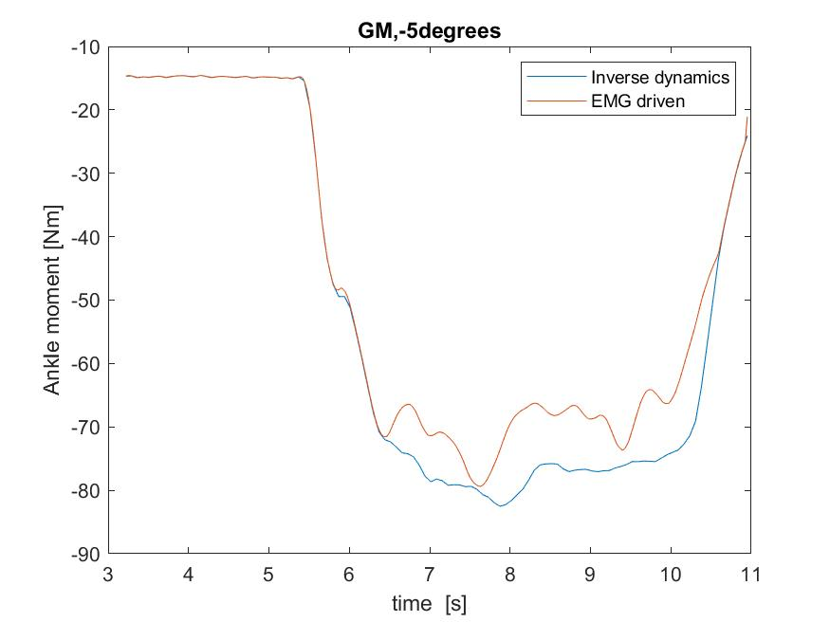
GM: Results
Weights:
wEMG = 0.001 wlM = 1 EMGbounds = [-0.1 0.1] BoundsScaleEMG = [0.2 1.5]
Comments:

Slide 6
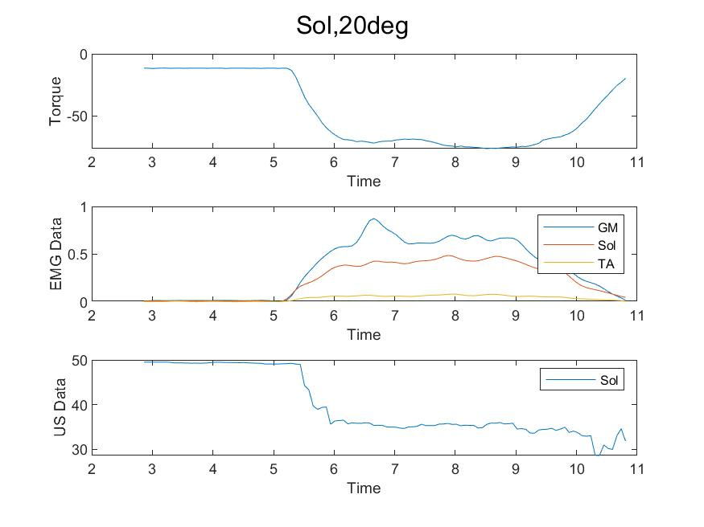
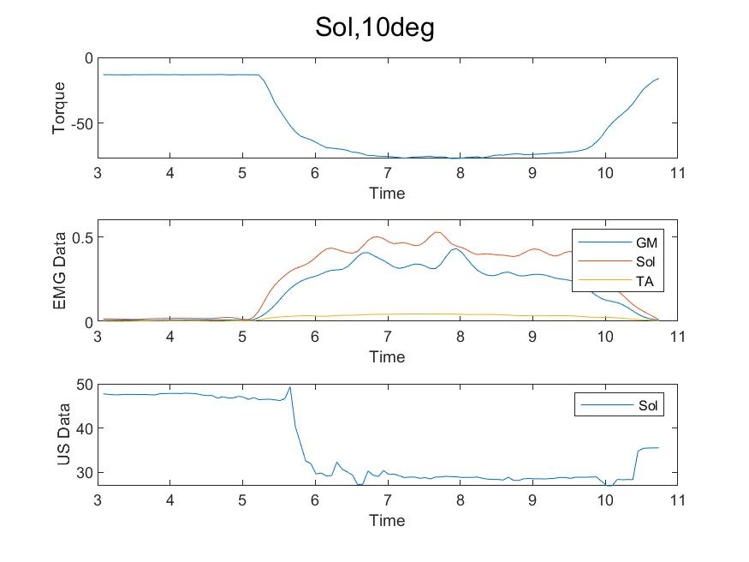
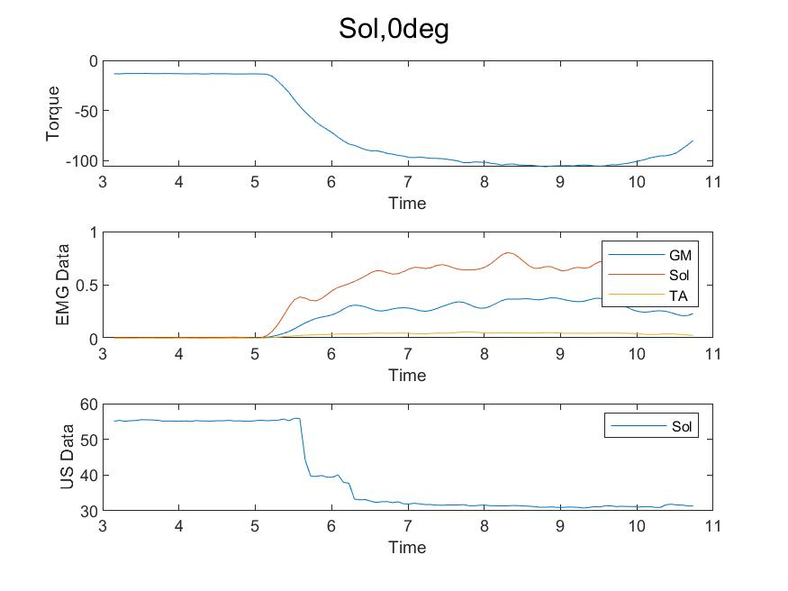
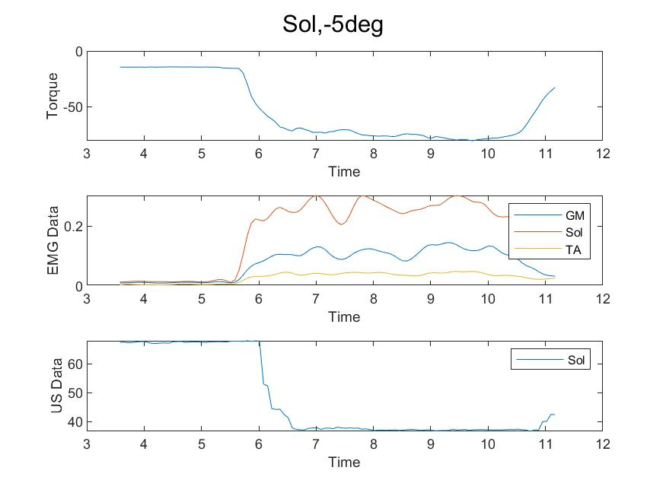
SOL: Pre-processing
Comments:
It looks a bit unsynchronized here, but the Marker file was very clear and I’ve double checked the frequencies on this one. If you look at the tracking's on the next slide, you can however see that it looks like the muscle is activating slightly before it’s actually moving though.

Slide 7
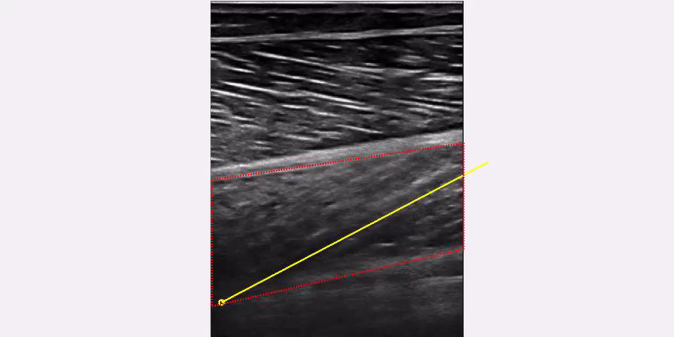
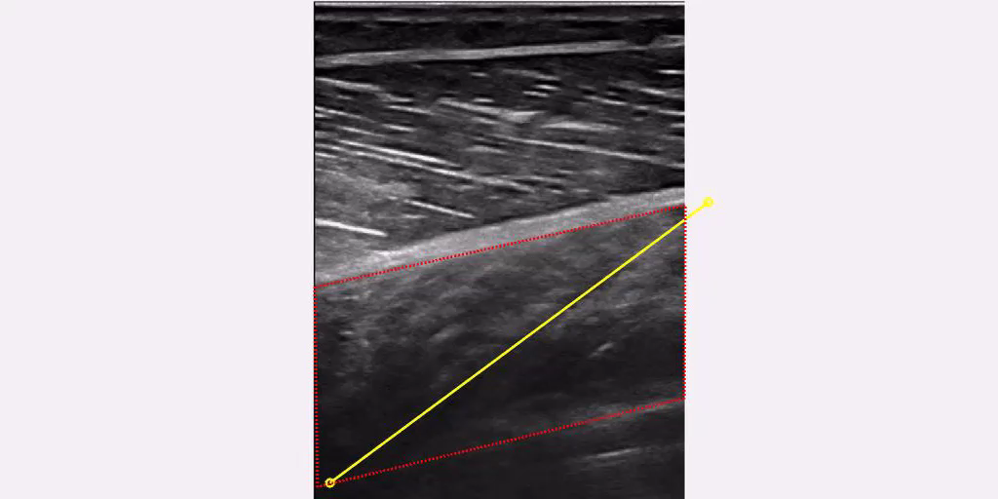
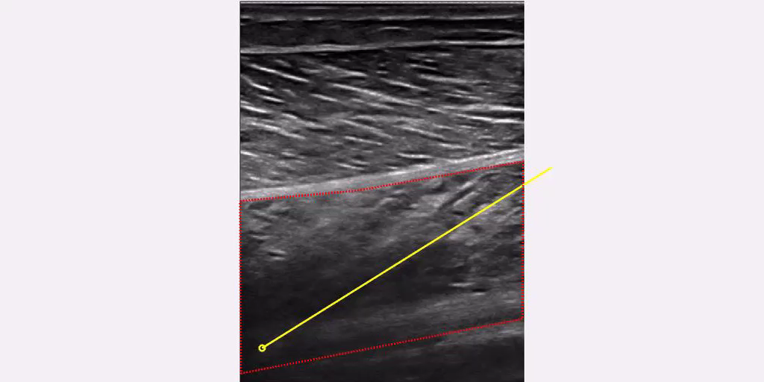
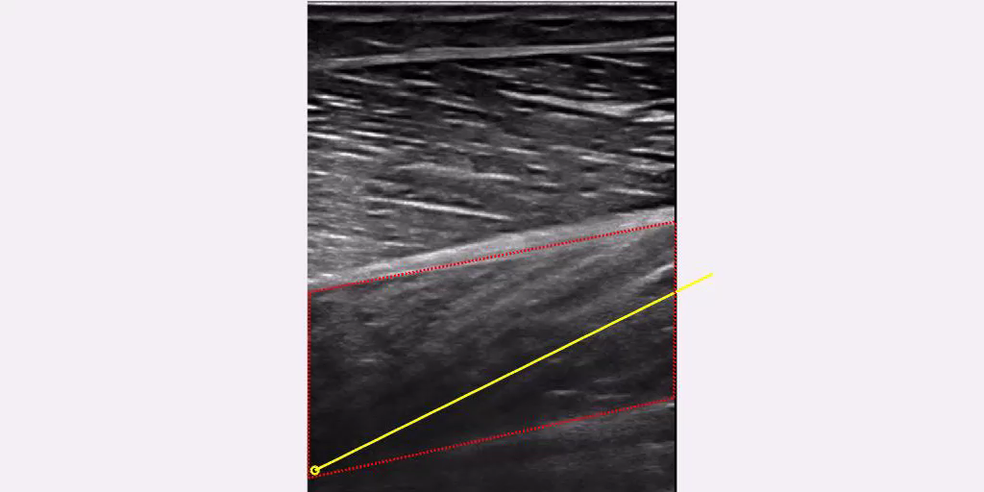
SOL: Pre-processing, US Tracking
Comments:
0 degrees
10 degrees
20 degrees
-5 degrees

Slide 8
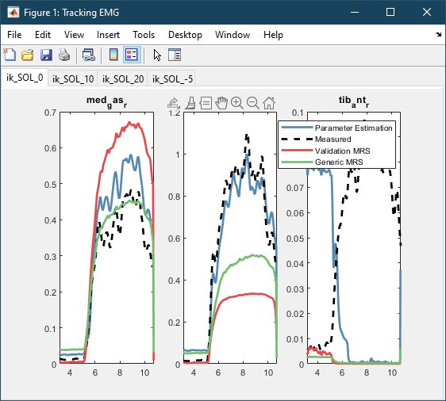
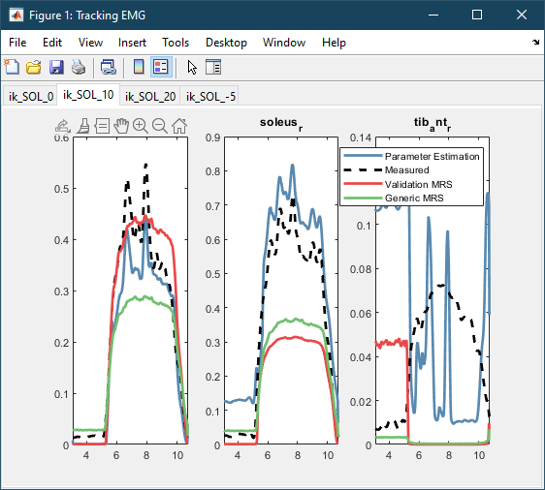
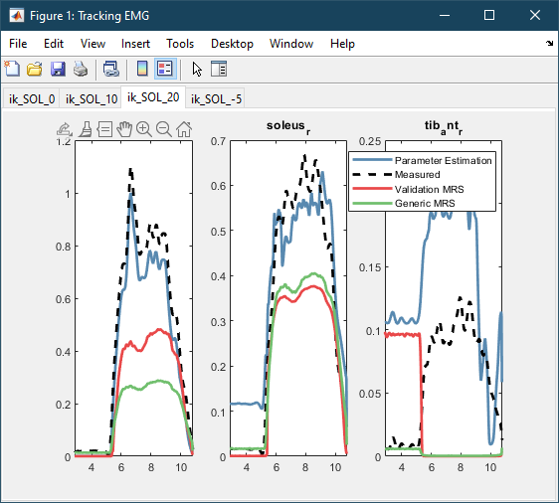
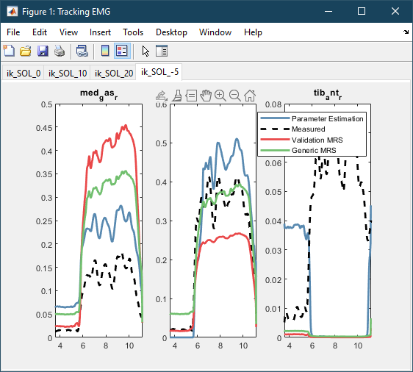
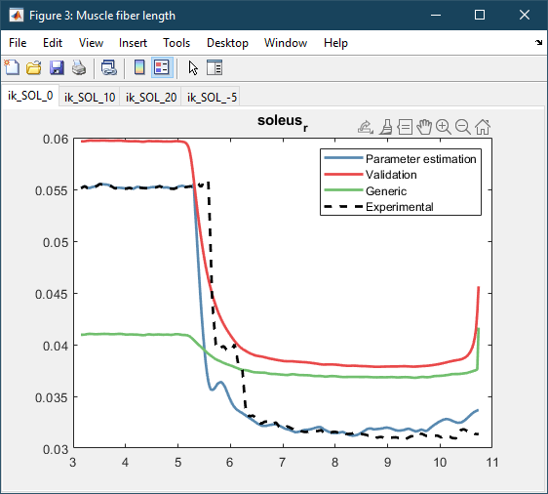
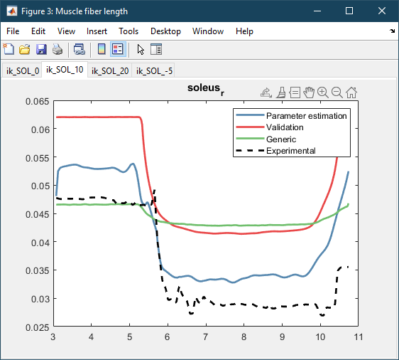
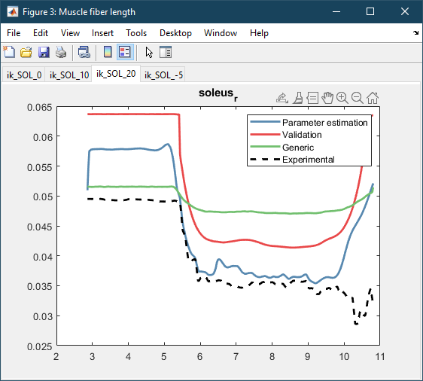
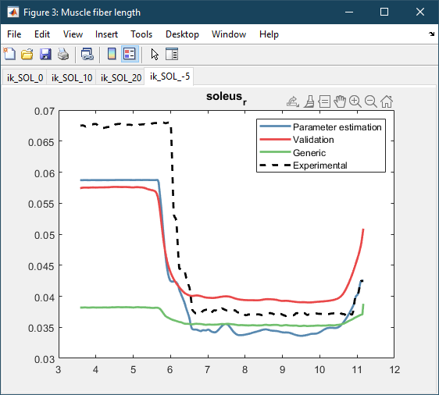
SOL: Results
Weights:
wEMG = 0.001 wlM = 1 EMGbounds = [-0.1 0.1] BoundsScaleEMG = [0.2 1.5]

Slide 9
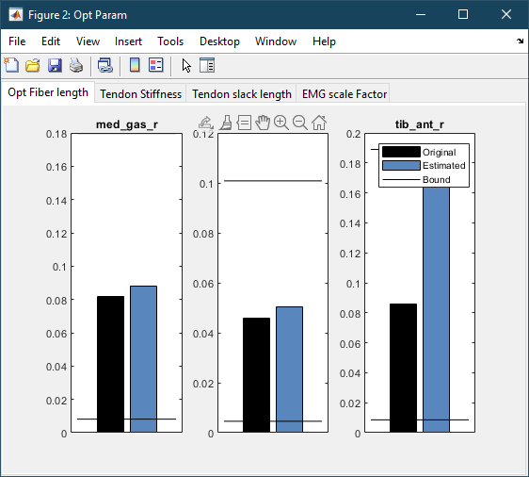
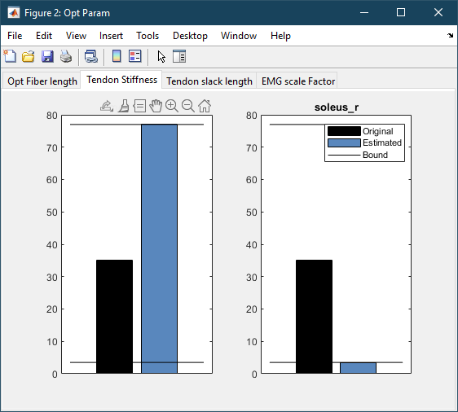
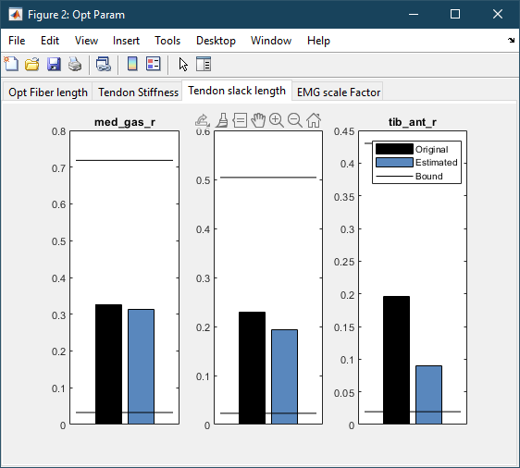
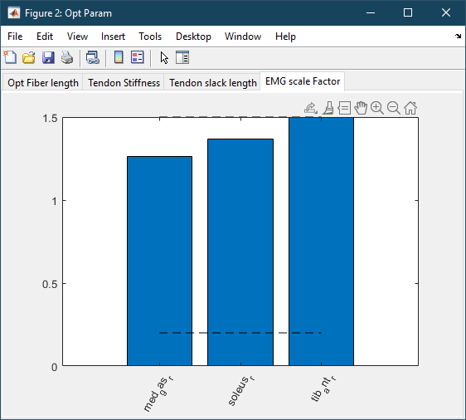
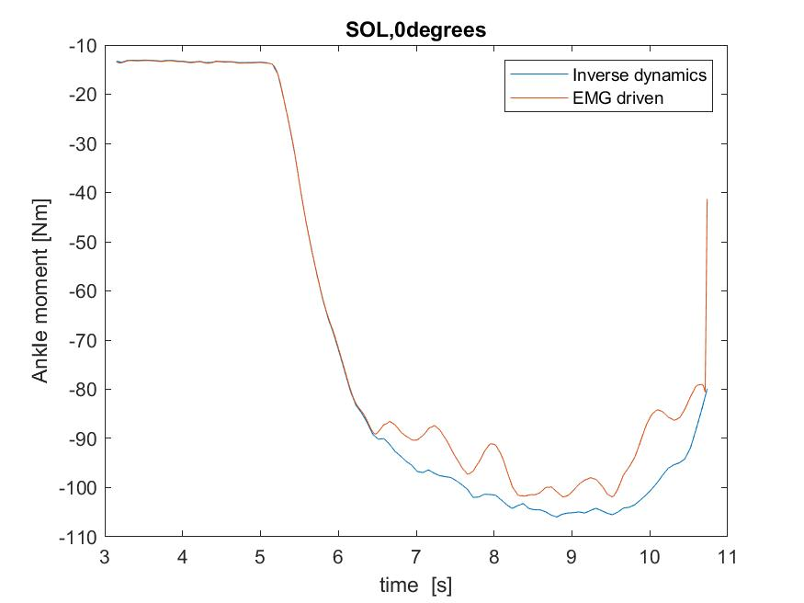
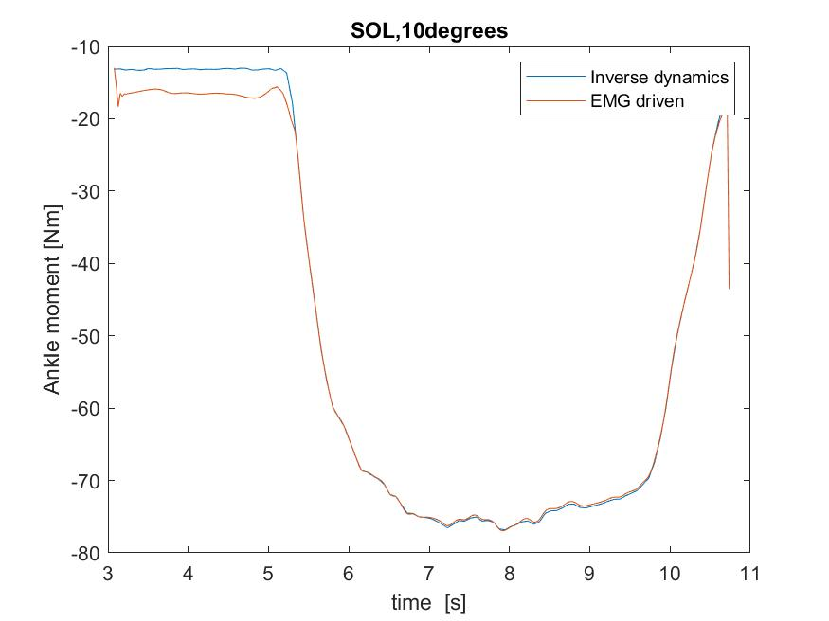
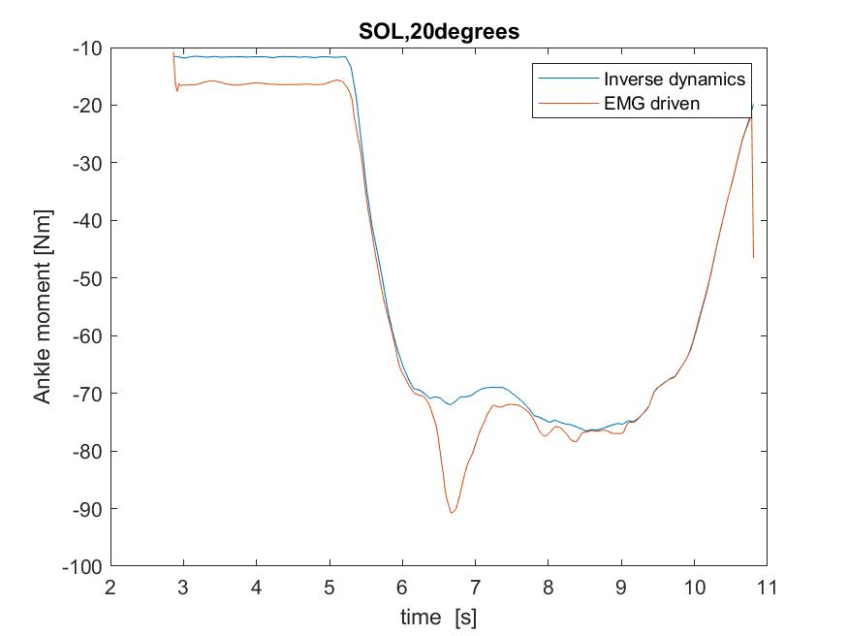
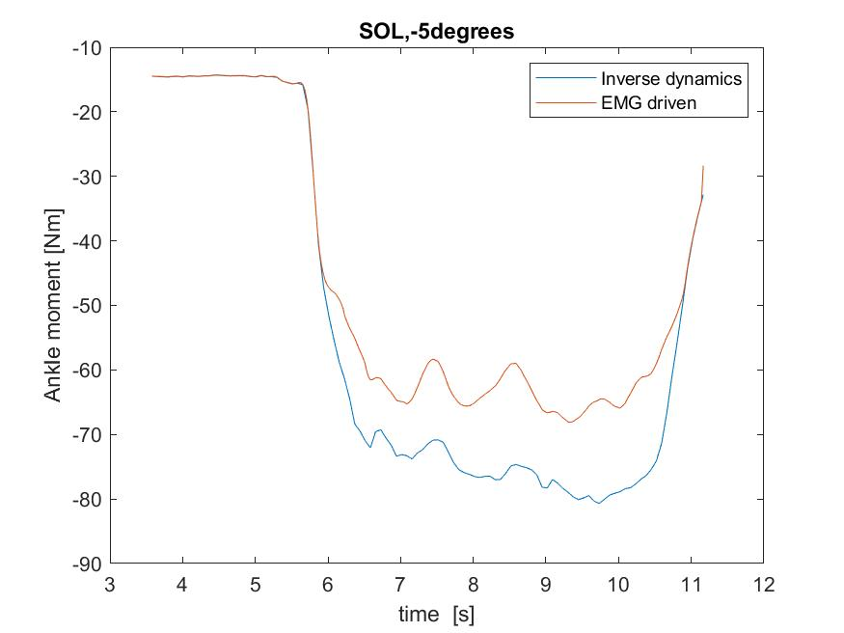
SOL: Results
Weights:
wEMG = 0.001 wlM = 1 EMGbounds = [-0.1 0.1] BoundsScaleEMG = [0.2 1.5]

Slide 10
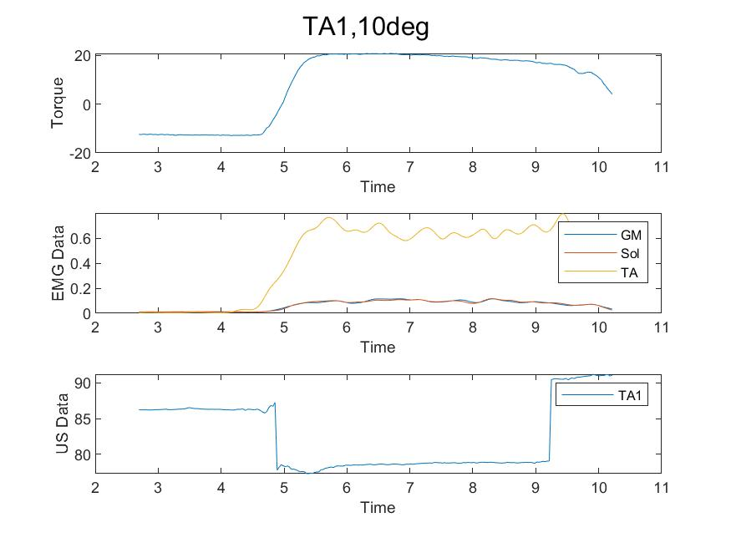
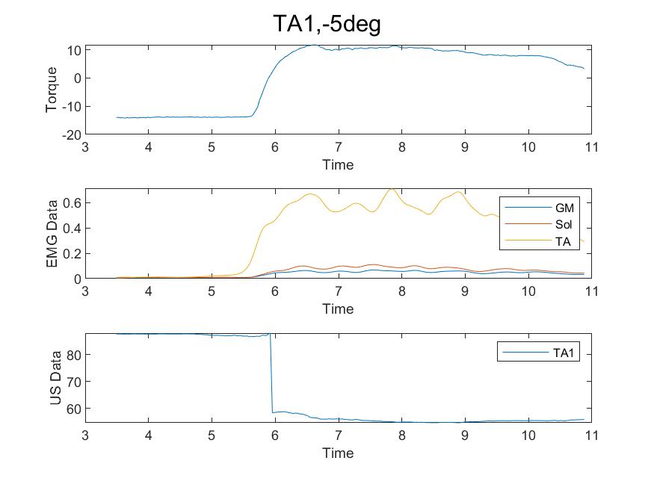


TA1: Pre-processing
Comments:
This one had the same issue as SOL, the muscle activates before it’s moving in the ultrasound.

Slide 11




TA1: Pre-processing, US Tracking
Comments:
0 degrees
10 degrees
20 degrees
-5 degrees

Slide 12








TA1: Results
Weights:
wEMG = 0.001 wlM = 1 EMGbounds = [-0.1 0.1] BoundsScaleEMG = [0.2 1.5]

Slide 13








TA1: Results
Weights:
wEMG = 0.001 wlM = 1 EMGbounds = [-0.1 0.1] BoundsScaleEMG = [0.2 1.5]

Slide 14




TA2: Pre-processing
Comments:

Slide 15




TA2: Pre-processing, US Tracking
Comments:
0 degrees
10 degrees
20 degrees
-5 degrees

Slide 16








TA2: Results
Weights:
wEMG = 0.001 wlM = 1 EMGbounds = [-0.1 0.1] BoundsScaleEMG = [0.2 1.5]

Slide 17








TA2: Results
Weights:
wEMG = 0.001 wlM = 1 EMGbounds = [-0.1 0.1] BoundsScaleEMG = [0.2 1.5]

